Slide 1

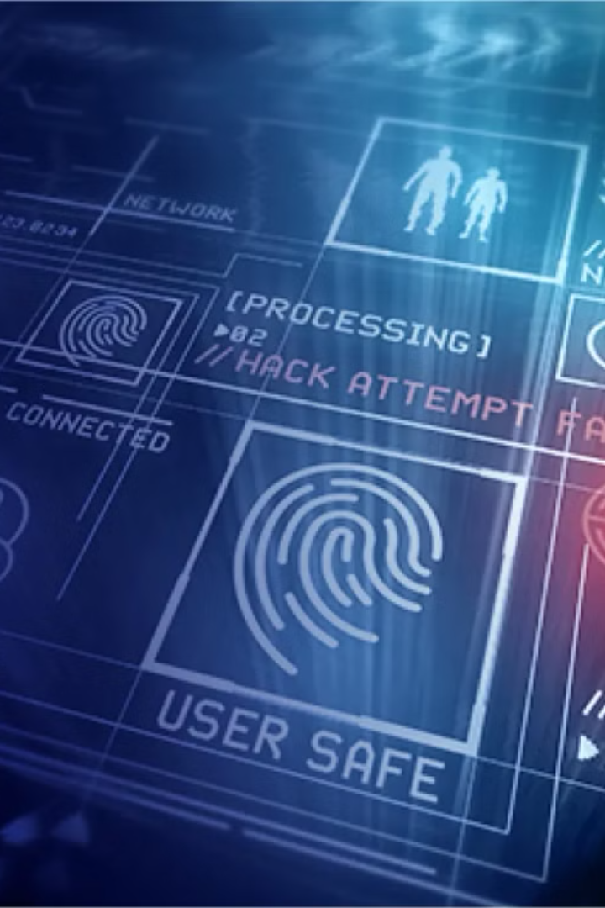

Webcam Spyware: The Silent Threat
ST#IS#6658
Webcam spyware is malicious software designed to secretly access and record your webcam. This type of spyware can be installed without your knowledge, allowing attackers to monitor your activities in real-time.
N PRANEETH

Slide 2


What is Webcam Spyware?
Types of Spyware
Operating System Compatibility
Webcam spyware can be installed through various methods, including malicious emails, infected websites, or hidden within legitimate software.
Spyware can be developed for all major operating systems, including Windows, macOS, and Android.
Functionality
Once installed, webcam spyware can secretly record video, capture screenshots, and even monitor your microphone.

Slide 3
Advantages of Webcam Spyware?
Surveillance
Remote Access
Evidence Gathering
Webcam spyware can be used for monitoring purposes, such as security and safety.
It allows users to remotely control their webcam and access live video feeds.
In legal or investigative situations, it can be used to gather evidence.

Slide 4

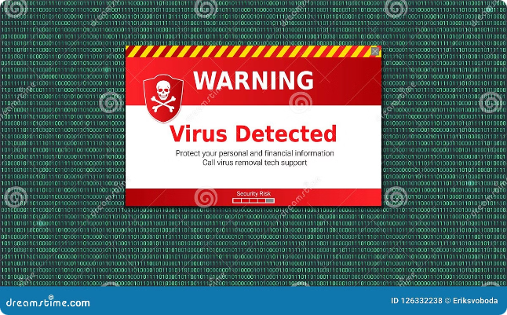
Disadvantages of Webcam Spyware
1
Privacy Invasion
2
Data Theft
It can be used to spy on individuals without their knowledge or consent.
It can be used to steal personal data, including passwords, financial information, and sensitive conversations.
3
Blackmail and Extortion
4
Reputation Damage
The leaked videos and images can severely damage an individual's reputation.
The recorded videos and screenshots can be used for blackmail or extortion.

Slide 5



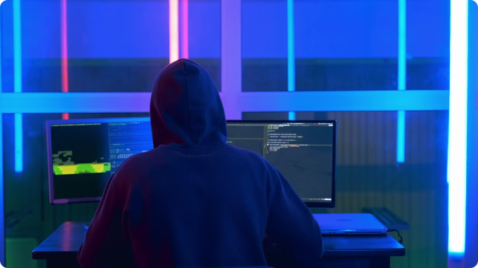


Purpose of Webcam Spyware
Espionage
Financial Gain
Spyware is used to gather intelligence on individuals or organizations for political, economic, or military purposes.
It can be used to steal financial information, passwords, and other valuable data.
Extortion
Revenge
Spyware can be used to blackmail or extort money from victims.
Individuals with grudges can use spyware to harass or embarrass their targets.

Slide 6


Risks of Webcam Spyware in Daily Life
1
Identity Theft
Spyware can steal your personal information, including passwords, financial data, and social security numbers.
2
Financial Loss
Hackers can use stolen financial information to make unauthorized purchases or empty your bank account.
3
Reputation Damage
Spyware can record and share embarrassing or compromising videos without your consent.
4
Emotional Distress
Being spied on can be an emotionally distressing experience, leading to anxiety and paranoia.

Slide 7


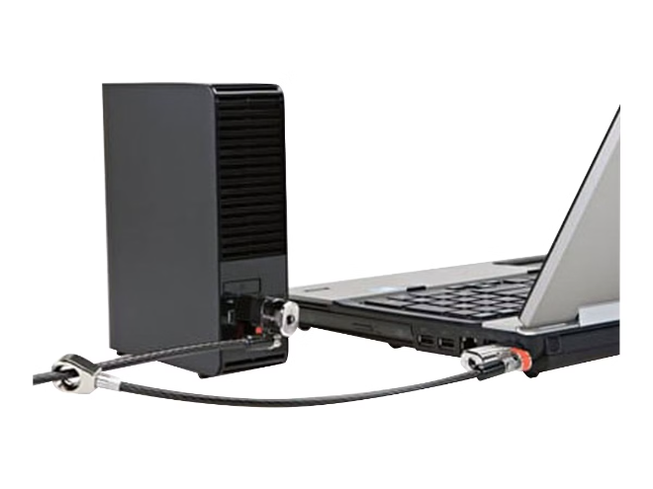



How to Prevent Webcam Spyware
Use Anti-Malware Software
Install and keep your anti-malware software updated to detect and remove spyware.
Be Cautious of Downloads
Only download software from trusted sources and avoid clicking suspicious links.
Keep Your Software Up to Date
Regularly update your operating system and software to patch vulnerabilities.
Cover Your Webcam
When not in use, cover your webcam with a physical cover to prevent unauthorized access.

Slide 8

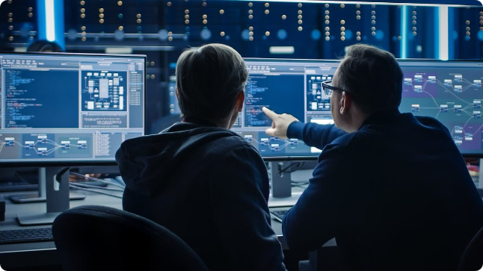
Conclusion and Key Takeaways
Protect your privacy.
Be cautious of suspicious downloads and emails.
Use a strong password.
Keep your software up-to-date.
Use anti-malware software.
Cover your webcam when not in use.

Slide 9

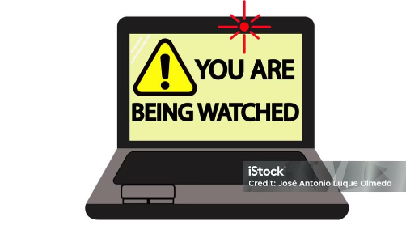
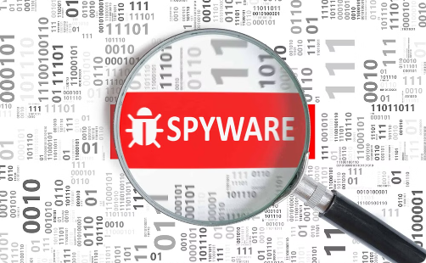

Unusual Webcam Activity
Privacy Warnings
Decreased System Performance
Unexplained camera light activation or unexpected webcam movements could be a sign of spyware.
Receiving alerts about unauthorized webcam access or privacy violations may indicate the presence of spyware.
Sudden slowdowns or crashes on your device could be a sign that spyware is running in the background.
Signs of Webcam Spyware
Webcam Indicator Light - Your webcam's indicator light may turn on unexpectedly, even when you're not using the camera.
Suspicious Applications - Keep an eye out for unknown programs running in the background that may be accessing your webcam.
Unexplained Video/Audio Recordings - Check for any unfamiliar video or audio files that could have been captured without your knowledge.
Unusual Network Activity - Monitor your computer's network traffic for suspicious data transfers that may indicate webcam spyware in action.
Decreased Performance - Spyware can slow down your system, so be aware of any unexplained performance issues.

